Slide 1

Automated Entities EXTRACTIon ON Insurance DOCUMENTS
Notes:
PP: Extraction plutot que Recognition

Slide 2

Foyer Insurance faced increasing challenges with addressing larger volumes of complex documents, such as co-insurance statements and "décompte" statements
Risk
100 documents
per day
100 co-insurance and documents statements received from adverse companies every day
Human errors
Increasing volume of documents
Shadow AI
50 companies
50 adverse companies with peculiar documents structure and formatting
> 30 entities
Every document contains between 30 and 50 entities to be retrieved (dates, amount, adversarial claim id, etc.)
Human indexer
Extraction of key entities is done manually by human indexers
Notes:
— adversarial_company_name (chaîne de caractères) : nom de l’entreprise adverse
envoyant le courrier - obligatoire ;
— adversarial_claim_id (chaîne de caractères) : identiant unique de l’entreprise adverse
permettant de référencer la demande - obligatoire ;
— reference_paiement (chaîne de caractères) : référence demandée par l’entreprise
adverse lors du paiement - obligatoire ;
— montant_reparation (ottant) : montant des réparations - optionnel ;
— montant_immobilisation (ottant) : montant de l’immobilisation du véhicule - optionnel
;
— montant_location (ottant) : montant des frais de location - optionnel ;
— montant_depannage (ottant) : montant des frais de dépannage - optionnel ;
— autres_frais (booléen) : présence d’autres frais - obligatoire ;
— devise (chaîne de caractères) : devise - obligatoire ;
— tva_deductible (chaîne de caractères) : tva déductible - obligatoire ;
— corporel (ottant) : montant des frais médicaux - optionnel ;
— total (ottant) : total des frais - optionnel ;
— pour les rapports d’expertise (sous-catégorie des décomptes) :
— rapport_expertise_joint (booléen) : indique la présence d’un rapport d’expertise
joint au décompte - obligatoire
— montant_HT_rapport_expertise (ottant) : montant estimé hors taxes - optionnel
— montant_TTC_rapport_expertise (ottant) : montant estimé toutes charges comprises
- optionnel
— tx_TVA_rapport_expertise (ottant) : taux de tva - optionnel
— nbre_de_jours_chomage (ottant) : nombre de jours de chômage - optionnel
Data Breaches due to Shadow AI ???

Slide 3
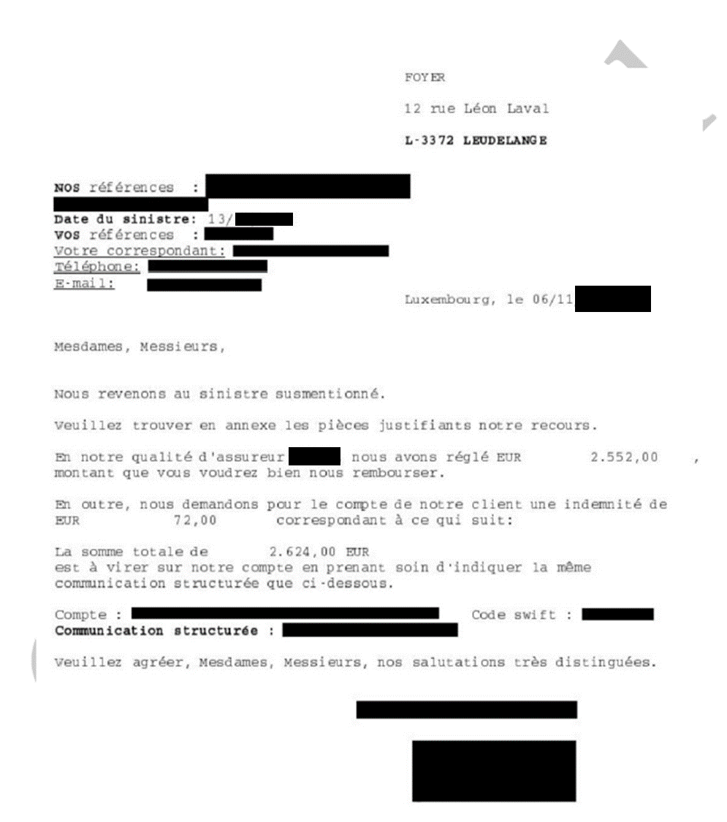

Processing large, unstructured documents required advanced tools, and proprietaries LLMs do not offer the requested level of security
+30
With more than 30 entities to extract, the combination of OCR + BERT/Mixtral 8x7B are not sufficient
+50
With more than 50 patterns of documents, Mixtral 8x7B is not able to generalize extraction
Proprietaries models expose vulnerabilities and are not compliant with Foyer security constraints.
Models must be locally hosted

Slide 4
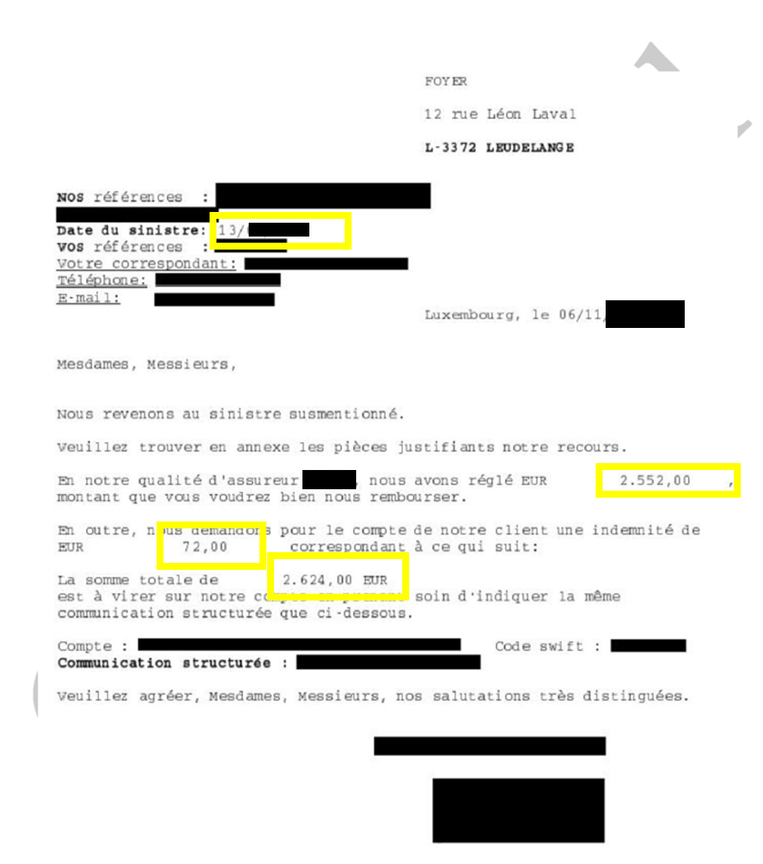
A mixture of Multimodal LLMs and RegEx allow to automate information extraction from co-insurance and "décompte" statements
Artificial Intelligence Models
Performance
Business Impact
Mixture of Multimodal LLM & RegEx
60% of the co-insurance and "décompte" statements received by indexers can be fully automated with 95% confidence interval
99%
60%
99% of the entities are extracted correctly
A finetuned 8B parameters Multimodal LLM, specialized over the entities extraction
OCR + Regex for other entities recognition
40% of the remaining co-insurance and settlement statements received by indexers can be semi-automated with human validation
40%

Slide 5







The technical Stack servicing automation
2x Junior Data Scientist (6 months)
BERT MLflow Python Mistral AI Large Language Model Hugging Face Llama 3.x
Donut 🍩

Slide 7

Automate ESG Responses from LPs surveys

Slide 8
Eurazeo, a leader in asset management and ESG integration, is facing increasing demand for accurate and detailed ESG reports
Increasing demands
Limited Partners (LPs) expect detailed and regular reports on ESG performance
Complex surveys
LPs send questionnaires covering hundreds of specific questions for each portfolio, with complex technical and regulatory requirements that comply with international standards such as SFDR, EU Taxonomy, etc.
>10 000 questions
Limited Partners collectively send over 10,000 questions annually to EURAZEO
10 minutes par question
The complexity of the responses requires meticulous work from Eurazeo's ESG teams, with 10 minutes per question, reaching up to 12.5 hours per survey

Slide 9
The deadlock of manual methods: an impossible equation between workload, speed, and accuracy in ESG responses
Risk
Diversity of surveys’ formats and specific requirements of LPs increase the likelihood of discrepancies in the quality of the responses
Risks of inconsistency
Risks of non-compliance
Shadow AI
Heterogeneous
Tight deadlines, limited resources
Completing an entire questionnaire takes around 12.5 hours, which increases the risk of delays, errors, or incomplete responses when multiple campaigns need to be managed simultaneously
Risk of non-compliance and delays: Meeting deadlines is critical to satisfy LPs, but the manual approach increases the risk of delays or incomplete responses
Manual

Slide 10
Adoption of an AI Tool to Automate ESG Responses
Artificial Intelligence Models
Performance
Business Impact
Reduction in the time required to answer a question
80% reduction in processing time per questionnaire, going from 12.5 hours to 2.5 hours with AI.
2mn
80%
GPT-4
AI answers a question in 2 minutes (vs. 10 minutes for a human)
90% accuracy rate
Scalability: Ability to handle thousands of questions simultaneously
Connection with Snowflake to process natural language queries
70%
70% of cost reduction with automation
Notes:
Outil disponible pour les experts métiers : Autonomie accrue et accès rapide aux données ESG pour des analyses approfondies.Conformité : Respect strict des normes ESG et des attentes des LPs, réduisant le risque de non-conformité.

Slide 11









Automated ESG questionnaire completion with AI engine
1x Senior Data Scientist (6 months) 1x Medior Data Scientist (6 months) 1x Advanced Full Stack Developer (3 months) 1x Expert Project Manager (6 months)
CI/CD Docker Flask GitLab Node.js NumPY Pandas Python SQL Prompt Streamlit Terraform

Slide 12

AMBULANCE handover DELAY PREDICTION

Slide 13
Keolis ship patients to hospital and often faces delays for the handover
Risk
Transfer optimization
Ambulances often face delays when handing over patients due to hospital inefficiencies, leading to idle vehicles and potential risks for patients
Increased Patient Harm: Delays in ambulance handovers can lead to patient harm, as timely medical interventions might be postponed. This can exacerbate health conditions and increase the risk of adverse outcomes
Operational Inefficiencies: Without predictive systems, hospitals may struggle with bottlenecks and overcrowding, leading to inefficient use of resources. This can result in longer wait times for patients and increased strain on healthcare staff
Seasonal effects
Use historical data on ambulance trips to train a machine learning model that predicts delays in patient handovers at hospitals
Various ranges of delays
Address the variability of delays across different hospitals and account for factors such as seasonality and hospital capacity

Slide 14


AKABI Implemented a PoC for handover delay prediction tool
Business Impact
Mean Absolute Error (MAE) of 5 minutes for the delays, corresponding to a prediction interval of 10 minutes
Optimization of Hospital Resources: Improving operational efficiency and reducing wait times for specialized care
Improvement in Patient Flow: Increasing hospital capacity and improving patient satisfaction
Cost Reduction: Using AI to anticipate care needs helps hospitals reduce the average length of hospital stays, freeing up resources for other patients
10 min
Integration of external data sources from OpenWeather and Waze routing API, with backend tools such as Azure SQL, Django, and scikit-learn could further improve it
Scaling the model to learn from multiple hospitals and incorporating additional data points like ambulance staff details and patient flow information to improve accuracy

Slide 15



Secure GPT & Generative AI
1x Junior Data Scientist (2 months)
Python
Azure DevOps
Azure AutoML
Random Forest
XGBoost

